Slide 1
Delete operation in Heap
The only element that should be deleted from heap is the root element.
Delete root element—last element will take its place—still complete binary tree—not a heap---maintain heap property by adjusting the elements by moving it downward from root to leaf. (direction of adjustment is downward)
The max time for delete operation is O(logn). The maximum adjustment you have to do, depends on height of binary tree.
Keep the deleted elements at the free space in the array, obtained after deleting root element.
Delete elements from heap, store them in vacant spaces in array, we will get sorted array.
When u delete element from heap, u will get max elements, the second delete operation will give the second max element
Notes:
The standard deletion operation on Heap is to delete the element present at the root node of the Heap. That is if it is a Max Heap, the standard deletion operation will delete the maximum element and if it is a Min heap, it will delete the minimum element.
You can delete any element from the heap but its not the standard operation and the leftover tree will no more complete binary tree and hence a heap

Slide 2
Time required for inserting a single element in a heap depends on height of binary tree i.e logn. We assume that element is moved up to the root.
Total time for inserting n elements in heap is nlogn
Time for deleting a single element form heap is logn.
Total time for deleting n elements from heap is nlogn
Total time for creating heap and deleting elements from heap is 2nlogn or O(nlogn)

Slide 3
Building a Heap
Convert an array A[1 … n] into a max-heap (n = length[A])
The elements in the subarray A[(⎣n/2⎦+1) .. n] are leaves
Apply MAX-HEAPIFY on elements between 1 and ⎣n/2⎦
Alg: BUILD-MAX-HEAP(A)
n = length[A]
for i ← ⎣n/2⎦ downto 1
do MAX-HEAPIFY(A, i, n)
1
4
2
3
1
3
4
5
6
7
2
16
9
10
8
9
10
14
8
7
A:
4 | 1 | 3 | 2 | 16 | 9 | 10 | 14 | 8 | 7

Slide 4
Example: A
4 | 1 | 3 | 2 | 16 | 9 | 10 | 14 | 8 | 7
i = 5
i = 4
i = 3
1
1
1
4
4
4
2
3
2
3
2
3
1
3
1
3
1
3
4
5
6
7
4
5
6
7
4
5
6
7
2
16
9
10
2
16
9
10
14
16
9
10
8
9
10
8
9
10
8
9
10
14
8
7
14
8
7
2
8
7
i = 2
i = 1
1
1
1
4
4
16
2
3
2
3
2
3
1
10
16
10
14
10
4
5
6
7
4
5
6
7
4
5
6
7
14
16
9
3
14
7
9
3
8
7
9
3
8
9
10
8
9
10
8
9
10
2
8
7
2
8
1
2
4
1

Slide 5
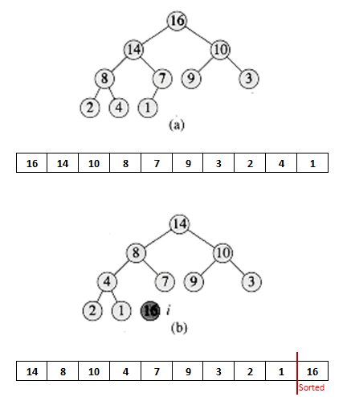
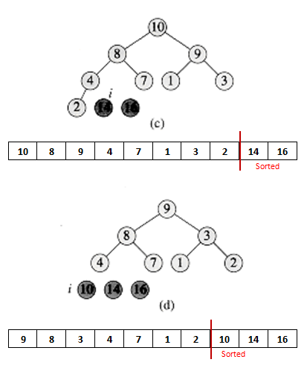

Slide 6
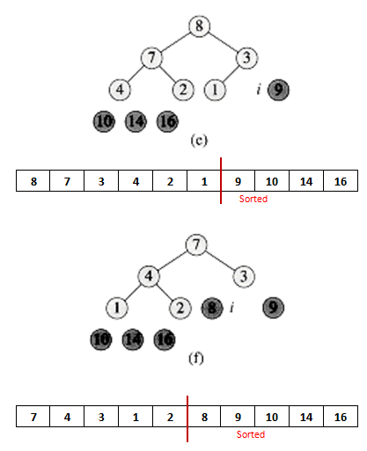
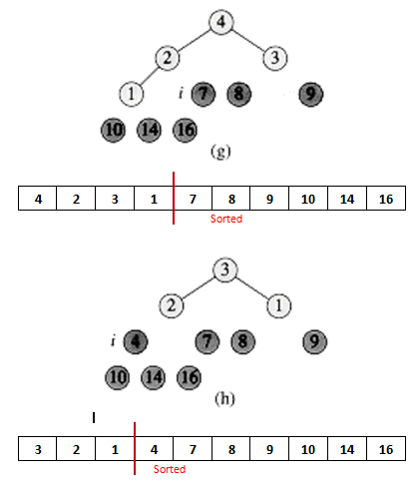

Slide 7
